Slide 1
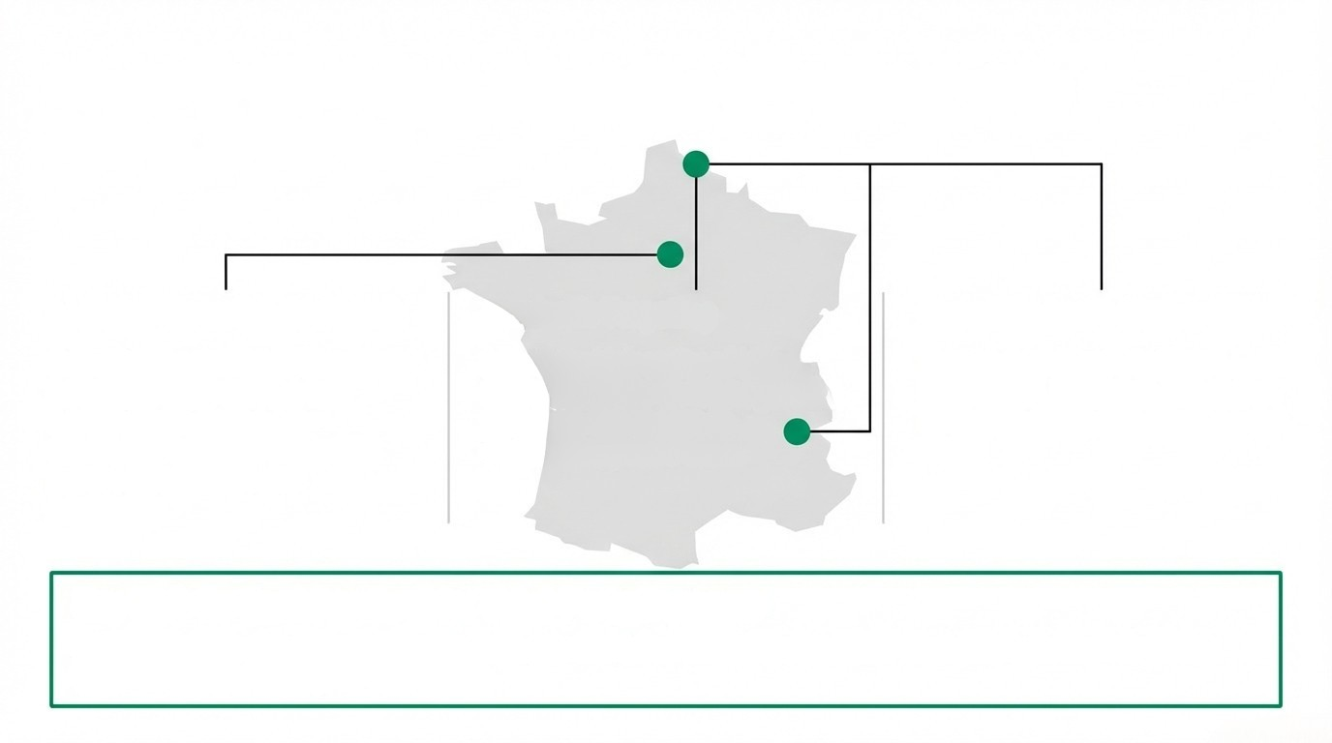
Regional Contagion: Escalation in French Public
Sector Targeting
Logistics Disruption (La Poste)
Dec 23: Massive DDoS paralyzed
national postal service and
banking arm during pre-
Christmas window. Disrupted
parcel distribution and
Academic Targeting
Mass Data Leaks (France Travail)
Late Dec: University of Lille &
Grenoble École de Management
targeted. Campaign to
destabilize public trust.
Breach impacted 1 million+
individuals. Dark web saturation
of French PII usable for financial
fraud.
payments.
Key Risk for Bank Leadership: Third-Party Exposure
Destabilization of national infrastructure providers increases 'ripple effect' disruptions to bank logistics
(card delivery) and payroll operations.

Slide 2

Critical Infrastructure Breach:
French Ministry of the
Interior ('Beauvau')
Dec 11-12
Dec 17
Impact
Initial Breach
Detected (Email
Infrastructure)
Suspect
Arrested
Exposure of
TAJ & FPR
Files
Root Cause
Data Exposure Impact
Key Risk for Bank Leadership
Not a Zero-Day. Driven by
credential negligence and
fundamental hygiene failures,
exposing fragility in
state-level perimeters.
Access to Criminal Records
Processing System (TAJ) and
Wanted Persons File (FPR).
KYC/AML Integrity: The
compromise of official
watchlists undermines
automated background
checks. Risk of sanctioned
entities bypassing
compliance filters using 'clean'
'identities derived from this
16.4 Million
Citizens' PII Potentially Exposed
breach.

Slide 3
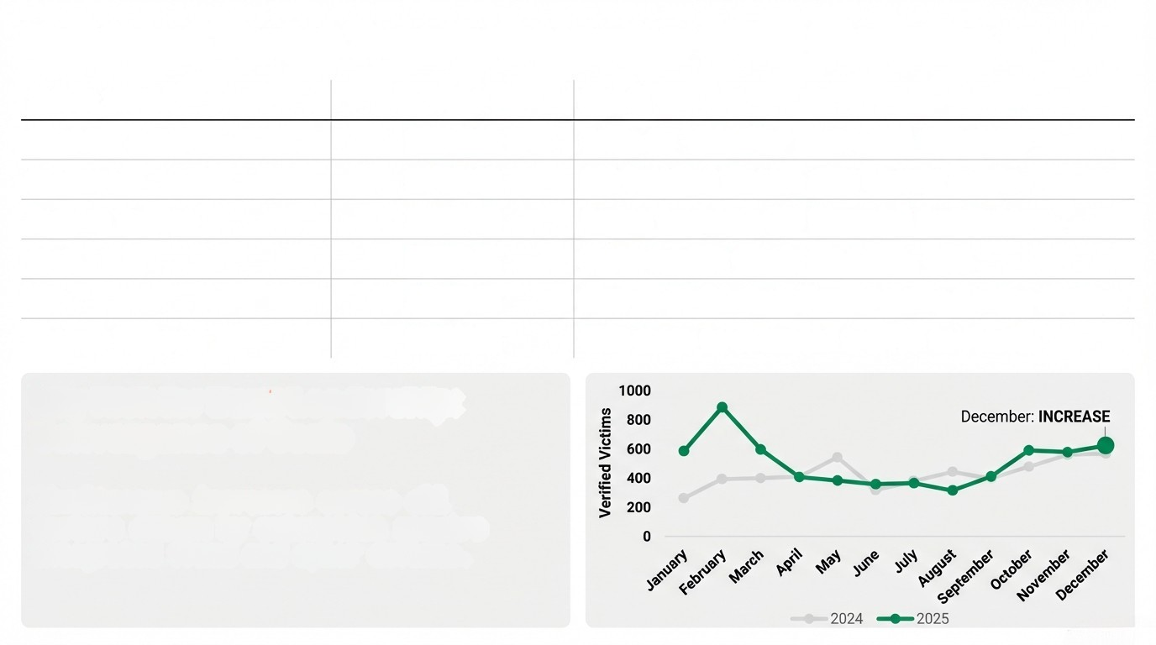
Validated Threat Trends: December 2025 Statistics
Threat Vector
Trend
Detail
Phishing
INCREASE
Surge in 'ClickFix' PowerShell technique.
Ransomware
INCREASE
839 Verified Victims (2nd highest month).
Anatsa targeting 831 financial institutions.
Multi-terabit floods (La Poste, UK).
Rise in AI-fabricated email chains & voice cloning.
520% surge in automated traffic to retail.
Banking Trojans
INCREASE
DDoS
INCREASE
BEC
INCREASE
Account Takeover
INCREASE
Key Risk for Bank Leadership:
Convergence of Scale
Simultaneous increases across all
vectors driven by automation require
integrated fraud and cyber defense.

Slide 4
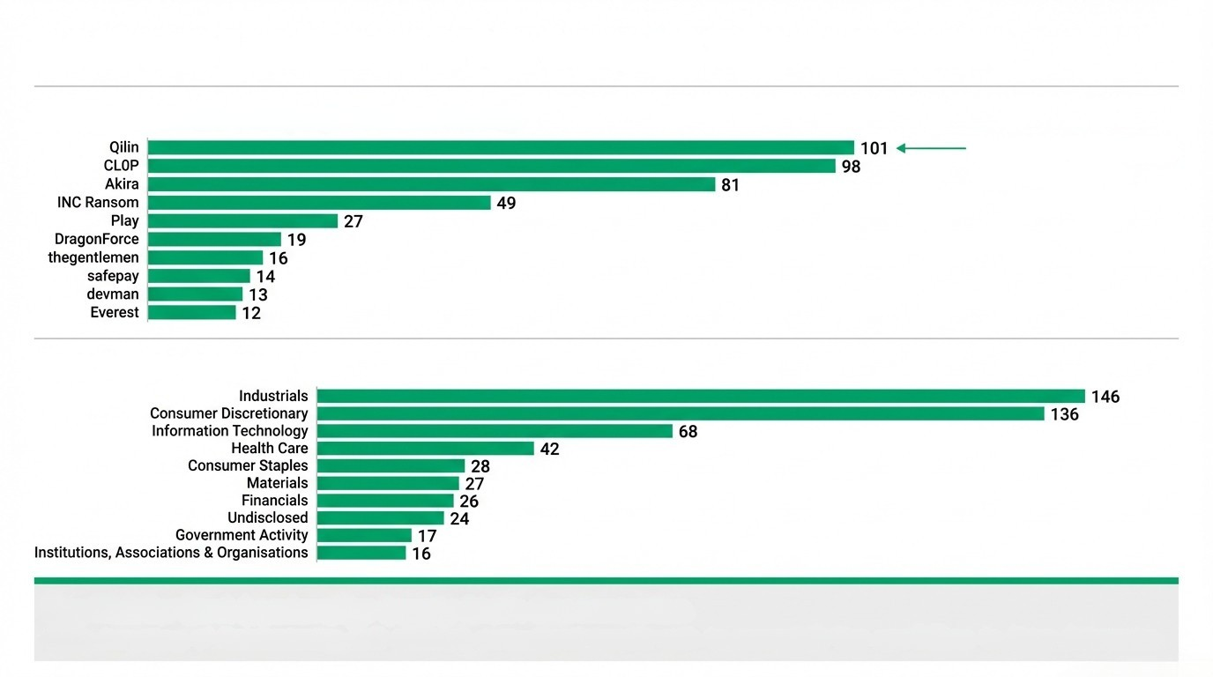
Adversary Leaderboard: Top Groups & Targeted Sectors
Top Ransomware Groups (December 2025)
Dominant Threat: 22%
of global volume.
Most Targeted Sectors
Key Risk for Bank Leadership: Supply Chain Concentration
Heavy targeting of Manufacturing (146 victims) poses direct credit risk to commercial loan portfolios in these industries.

